Slide 1
Erasmus+
Call
2024/25
Informative meeting
8th February 2024
International Mobility and Promotion Office

Slide 2
«Those who carried out a study abroad period, recognized by their degree course, have a higher chance of finding employment compared to those that never did a mobility abroad (+15,4%).»
AlmaLaurea Survey on Graduates’ profile 2022, p. 8

Slide 3
THE ERASMUS+ PROGRAMME
WHAT? Study abroad experience, recognised in your UNIMI career– Recognition of exams and credits;
WHY? Cultural and linguistic enrichment. Competitive CV and advantage in the job market;
WHERE? In a European country, at one of UNIMI’s partner universities;
WHEN/HOW LONG? Academic year 24/25. Depending on the duration defined by the bilateral agreement, one semester or a whole academic year. 12 months, between study and traineeship, for each study cycle (24 months for single-cycle courses). Min 2, max 12 months for academic year. All the mobilities must end by the 31st of July 2025.
WHO? Students regularly enrolled in the a.y. 24/25, who are not off- track by more than one year at the time of application for the current cycle of study (or, if off track for 2 years and no more during the Bachelor’s, selecting the mobility during the Master’s degree)
FINANCIAL SUPPORT? Erasmus+ scholarship based on the destination country and potential additional contribution based on the income.
HOW? Online application, from 9th to 29th February, at 1 pm. Don’t wait until the last day!

Slide 4
DEADLINES
DEADLINE FOR SUBMITTING YOUR ONLINE APPLICATION
29th FEBRUARY 2024, 1 PM.
APPLICATIONS NOT COMPLETED BEFORE THE DEADLINE WILL NOT BE CONSIDERED.
Submit your application well in advance!

Slide 5
Financial support
European scholarship for all the Erasmus students, from 250 to 350 euros/ month, depending on the destination;
Top-up for “green” travel;
Supplementary aid for students with fewer opportunities
Potential additional grant based on ISEE already submitted for a.y. 2023/24 / on the country of origin;

Slide 6
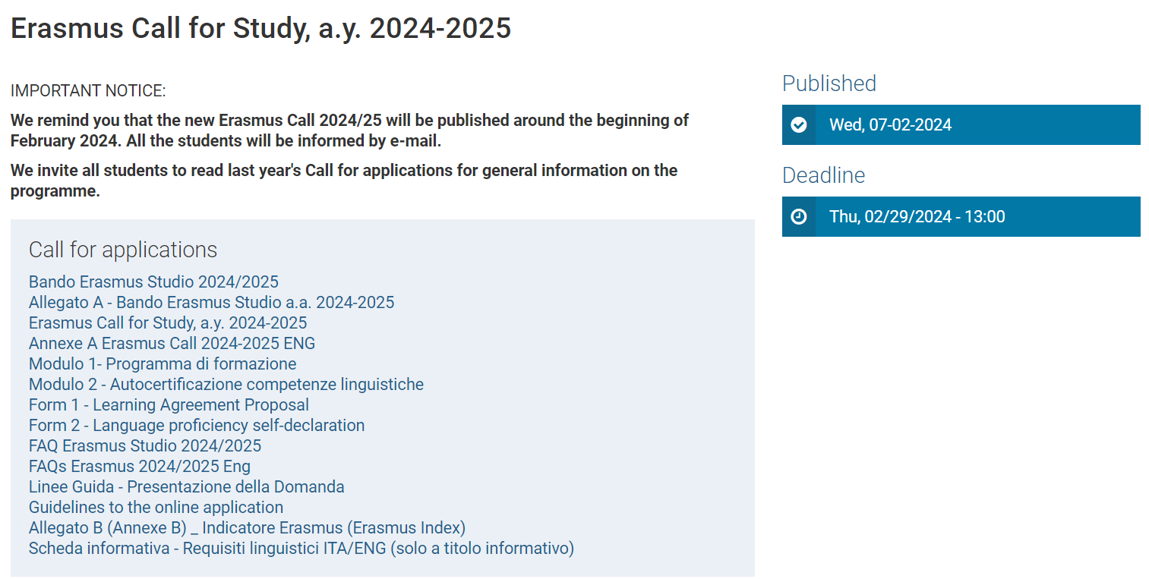
Where to find the Call and all the relevant information
Erasmus Call for Study, a.y. 2024-2025 | Università degli Studi di Milano Statale (unimi.it)
You’ll find:
The Erasmus Call
Annexe A
Form 1
Form 2
Faq
Guidelines

Slide 7
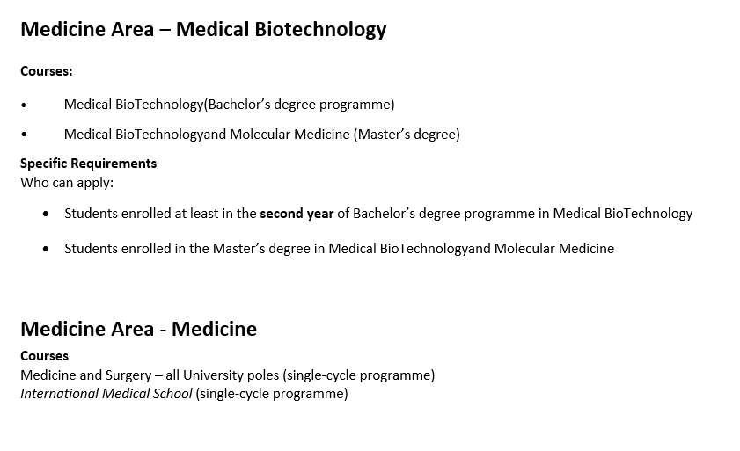
Annexe A
All the requirements for your study course and the selection criteria

Slide 8
MANDATORY ATTACHMENTS FOR THE APPLICATION
Language knowledge
Learning Agreement proposal
CV and previous career
Valid ID document

Slide 9
Language requirements
Minimum A2 level in the working language used at the host university required.
How can I know which is the working language? You have to visit the websites of the universities of your interest and check their academic offer.
All the students need to submit a certification recognized by the University/SLAM statement/ screenshot of their career where the level obtained is clearly stated.
Exceptions: Students from the Areas of Language Mediation, Veterinary Sciences and Foreign Languages, students who study in English (→ Form 2: Self-certification of language skills + oral interview).

Slide 10
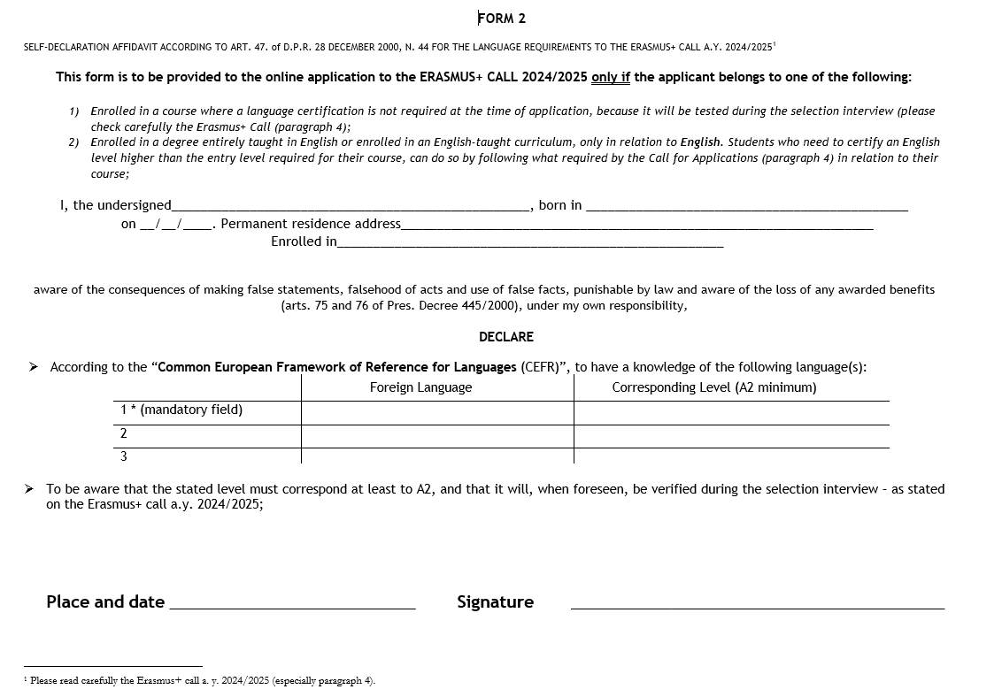
Self-certification of language knowledge (Form 2)
Only for Mediation, Veterinary, Languages + enrolled in an English-taught degree course

Slide 11
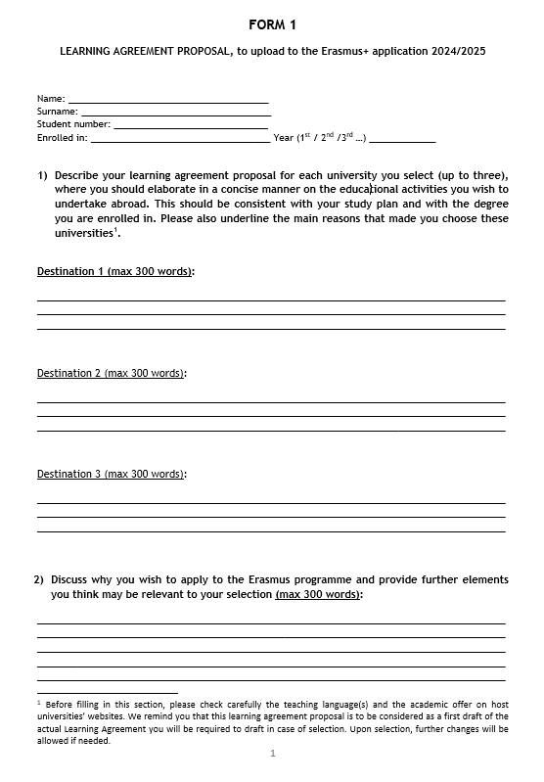
Learning Agreement proposal (Form 1)
Activities to be carried out abroad and motivations
1 academic year: (about) 60 credits
1 semester: 30 credits
1 semester: 20 credits

Slide 12
CV AND PREVIOUS CAREER (in one document)
Bachelor’s student? → download self-certification of Bachelor’s career from UNIMIA.
Master’s student/student from another University? → download self-certification of Master’s career from UNIMIA + proof of previous studies with final degree mark (from UNIMIA if the student is a Unimi graduate)

Slide 13
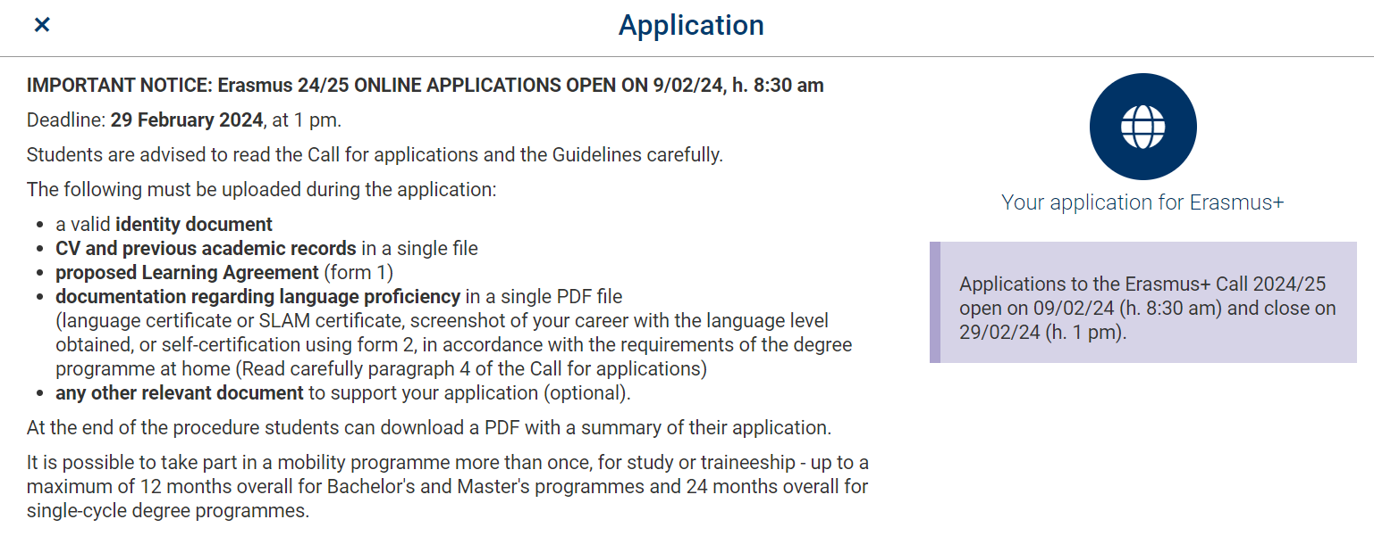
WHERE TO APPLY

Slide 14
SELECTION PROCEDURE
TOTAL SCORE
(Max. 30 points)
Application’s evaluation (with oral interview, when required)
Erasmus index

Slide 15
1. APPLICATION EVALUATION
You will be evaluated by a designated Commision on three components (Language, Learning Agreement, CV and career) according to the criteria indicated in the Annexe A and scores that will be communicated later.
You must undertake the oral interview, or you will be banned from the selections (only when required by the Call).
To be eligible, you must obtain at least 1 point in each component.
Min. 3 points - Max. 15 points

Slide 16
Erasmus Index
Number calculated with reference to the year of enrollment, the GPA and the credits obtained so far
Only the exams taken and registered on your career before 29/02/2024 will be considered. PARTIAL EXAMS cannot be included!
The Erasmus Index will be on a 15-point basis.

Slide 17
INTERVIEWS (when required)
The interviews will take place between March 11 and March 15, 2024.
The date and place of the interviews will be published with at least 10 days notice on the page:
Remind to check regularly this page.

Slide 18
RESULTS
Published by April 5th 2024 on the page:
Within 5 days of the publication of the results, selected students can accept or waive their offered place within 5 working days starting from the date following the the results through the following link: https://studente.unimi.it/erasmus-domanda/login

Slide 19
REPLACEMENTS
Vacant Eligible students who were not selected for any destination will be put on the waitlist for each destination they were eligible for.
After the first window for acceptance is closed, the online platform will generate a new ranking, reassigning any vacant places to eligible students on the waitlist. Students, summoned by ranking order, may choose whether to accept or waive a vacant destination within the second acceptance window. The students will be informed of the dates of this second acceptance window.
Students on the waitlist can be called until July 16, 2024.
Selected students who withdraw from the assigned destination will not be considered for their second or third choices.
If a student on the waitlist is offered a destination on their application and they do not accept it, they will not be reconsidered for other destinations.

Slide 20
Informative meetings by area
Many Commissions have organised informative meetings dedicated to their students, to better define academic matters and details regarding the language requirements, the Learning Agreement and the destinations.
To check if a specific meeting has been organized for your study course/area, visit this page:

Slide 21
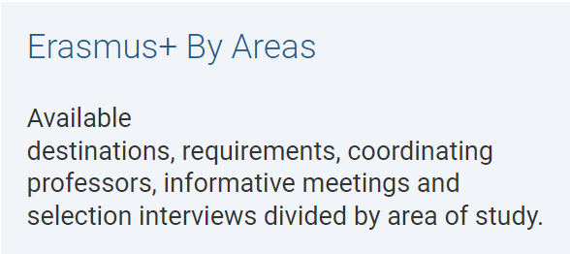
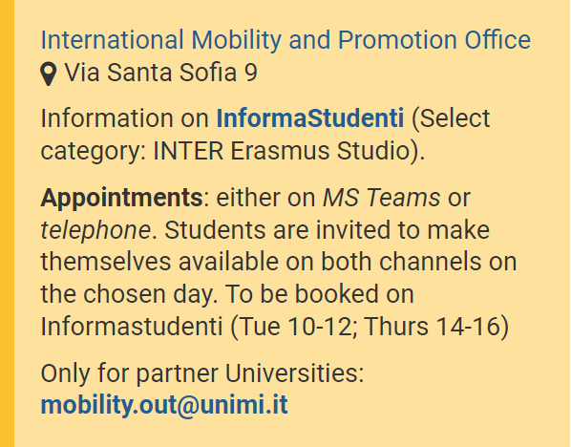
CONTACTS
FOR ACADEMIC MATTERS
INTERNATIONAL MOBILITY OFFICE
(for questions regarding administrative matters)
Informastudenti > INTER Erasmus Studio > Call and selections

